Slide 1
DATA ANALYSIS & VISUALIZATION PROJECT
RAHUL KHUBCHANDANI
SAHIL LANDGE

Slide 2

IPL ANALYSIS
The Indian Premier League (IPL), also known as TATA IPL for sponsorship reasons, is a men's T20 franchise cricket league of India. It is annually contested by ten teams based out of seven Indian cities and three Indian states.[1][2] The league was founded by the Board of Control for Cricket in India (BCCI) in 2007.

Slide 3
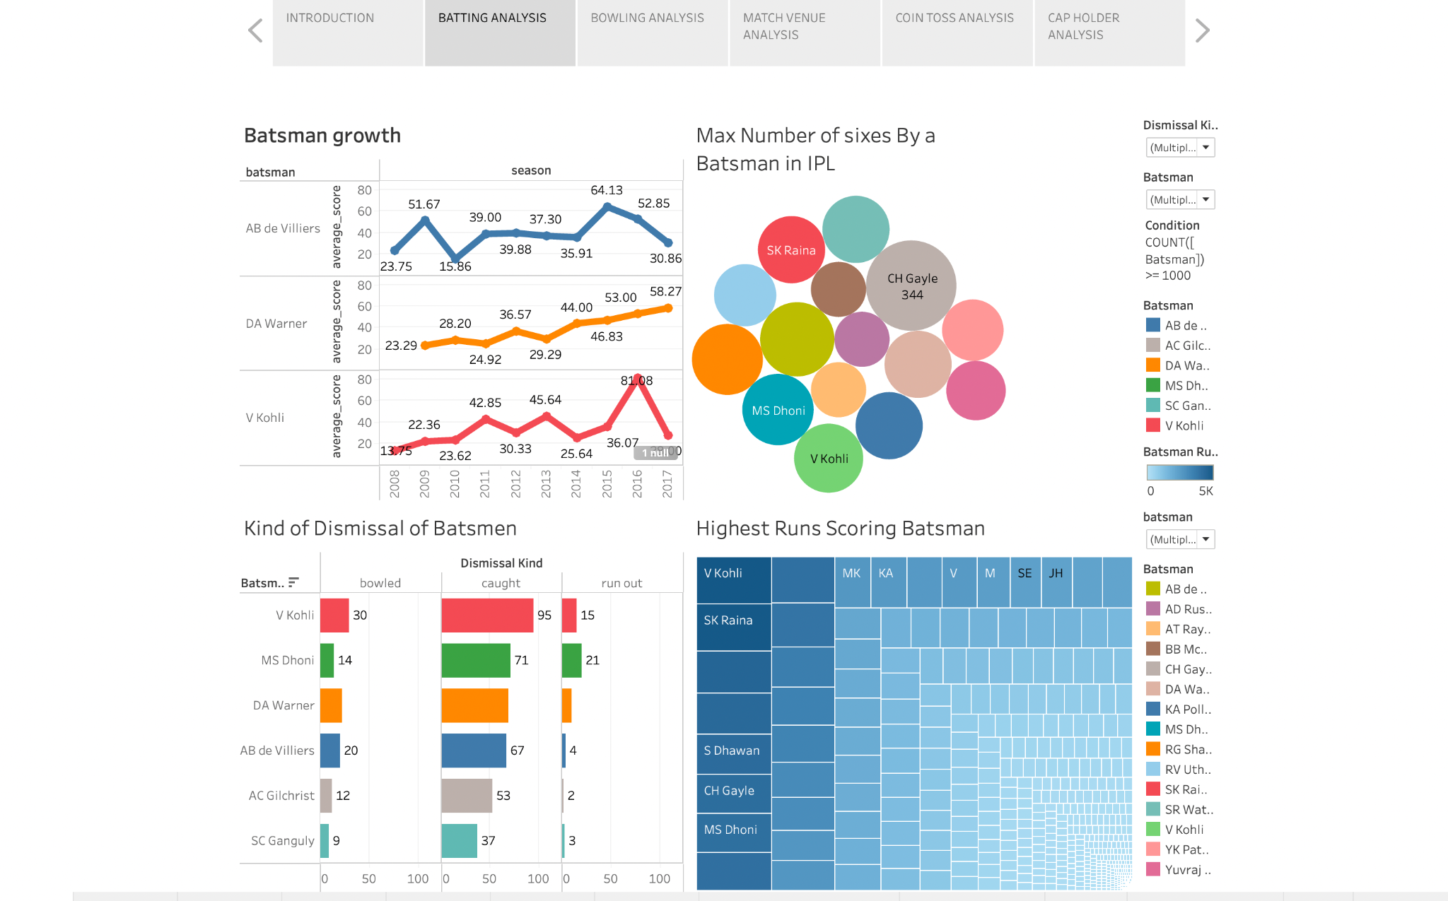

Slide 4
DASHBOARD INSIGHTS
Here in the above dashboard we are analyzing batsmen on the basis of their growth, number of sixes scored, type of dismissal, highest run scored.
Insights -
From the Batsman growth chart, we can see that DA Warner has a good increasing performance in the matches played over all in making runs. V Kohli was averaging decently over the years but his performance has drastically decreased after 2016.
From the Max number of sixes by Batsman chart, we can see the players with the number of sixes they have scored over all during all seasons. CH Gayle has topped the list by scoring highest number scores by scoring total 344 sixes over all.
From the Kind of Dismissal of Batsmen chart, we can see how each player was out by different forms like bowled, caught, run out & many more. V. Kohli was bowled 30 times, caught 95 times & run out 15 times during all the matches he played.
From the Highest Run Scoring Batsman chat, we can see that on the top left most corner is the player who has scored the most number of runs ( i.e V. Kohli ) & on the bottom right corner is the player who has scored the least number of runs in over all matches( i.e Abdur Razzak).

Slide 5
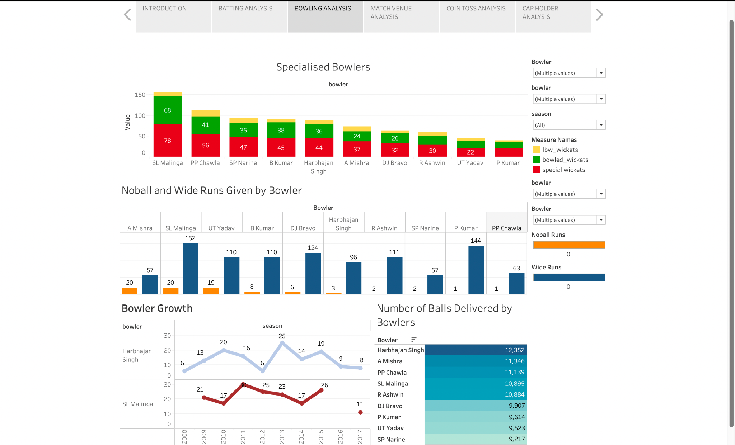

Slide 6
DASHBOARD INSIGHTS
Here in the above chart we are analyzing bowlers based on number of wickets they have taken in different forms, no & wide ball runs given, highest number of balls delivered, growth.
Insights -
From the Specialized bowlers chart, we can see analysis on how a player has taken different wickets in different forms like lbw, bowled, special. SL Malinga has topped the chart in taking the highest number of wickets and to be specific 10 by lbw and 68 bowled.
From the No & Wide Ball Runs chart, we can see the players who gave runs in the form of no or wide ball deliveries. For instance, A Mishra has give 57 wide runs & 20 no ball runs.
From the bowler growth chart, we can analyze performance of players overall in the matches they have bowled which tells us how good or bad they have made their game over the years. H Singh has a seasonal trend in all the matches where we can see that his performance is not constantly increasing/decreasing but is full of ups and downs. The best he had done was taking 25 wickets in some season.
From the number of balls delivered by the bowlers chart, we have created a table which shows different player with respect to the delivers they have made over all in descending order.

Slide 7
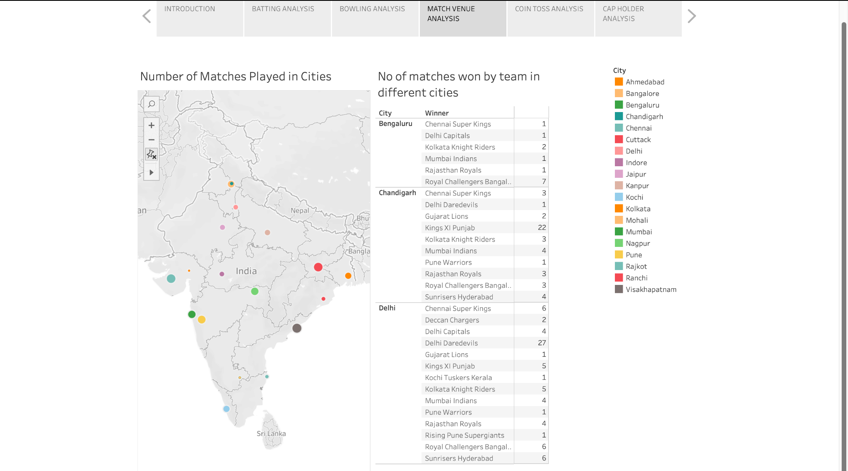

Slide 8
DASHBOARD INSIGHTS
Here in the above chart we are analyzing how many different cities of India matches were held and in those cities where matches were held which teams have won matches on the field of those cities.
Insights -
From the Number of Matches Played in Cities chart, Mumbai was the city with the highest number of games (101) and Kanpur was the city with the lowest number of games (4) played.
From the number of matches won by a team in different cities chart, we can see how many times different teams have won matches in different cities. In Delhi, Delhi Daredevils have won the highest number of matches which is 27. In Chandigarh, Pune Warriors & Delhi Daredevils have won the lowest number of matches.

Slide 9
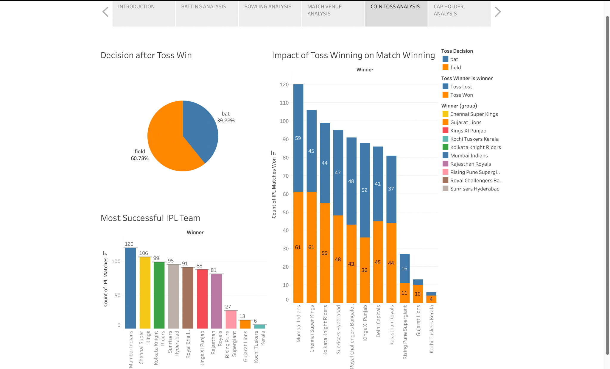

Slide 10
DASHBOARD INSIGHTS
Here in the above chart we are analyzing the toss decision, the impact it has on different teams & the result of the matches.
From the Decision after Toss Win chart, we can understand that the percentage of choosing the field is more than bat.
From the Impact of Toss Winning on Match Winning chart, Mumbai has won the maximum number of tosses (61), Chennai Super Kings have also won the same number of tosses & so on for other teams. Now, from the Most Successful IPL Team chart, Mumbai Indians is leading with the number of seasons won followed by Chennai Super Kings and so on. It basically implies that the team who has won the most number of tosses is most likely to win the match.

Slide 11
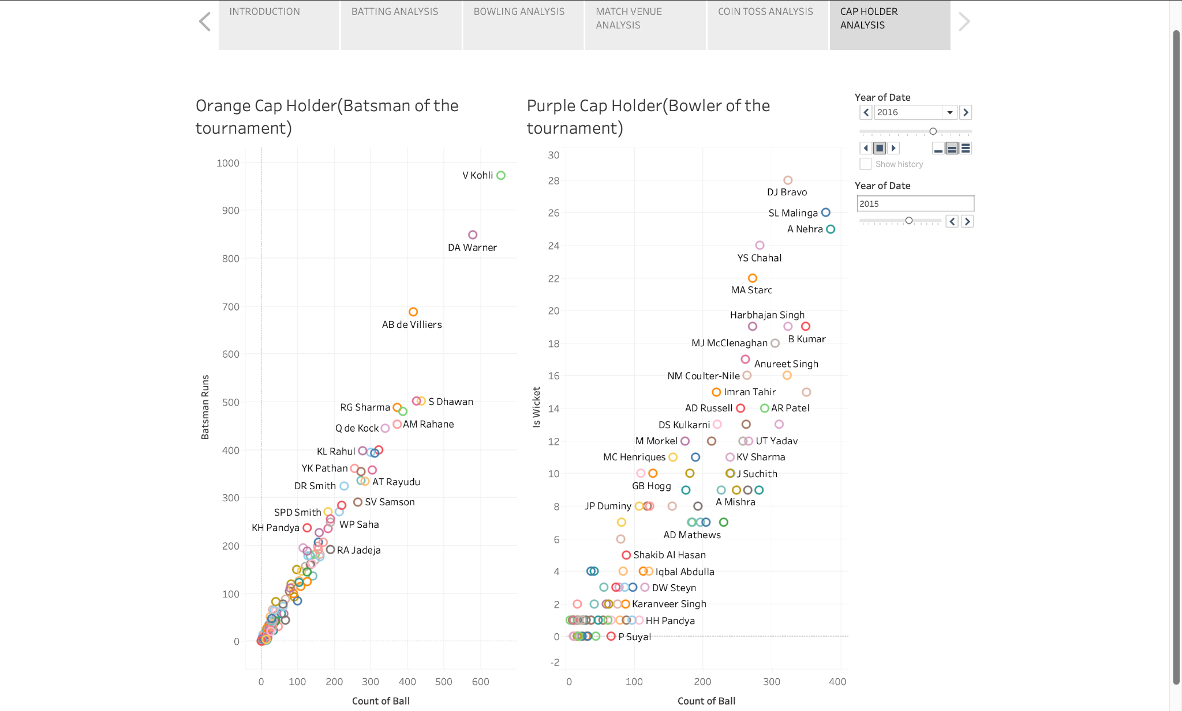

Slide 12
DASHBOARD INSIGHTS
Here in the above chart we are analyzing the bowlers & batsmen who got purple & orange cap based on their performance each year.
Insights -
From the Orange Cap Holder chart, we see the player that has scored the highest numbers of runs each year and received the cap in honor. V. Kohli got the Orange Cap in 2016.
From the Purple Cap Holder chart, we see the player that has taken the highest numbers of wickets each year and received the cap in honor. DJ Bravo got the Purple Cap in 2015.

Slide 13
THANK YOU

